Slide 1
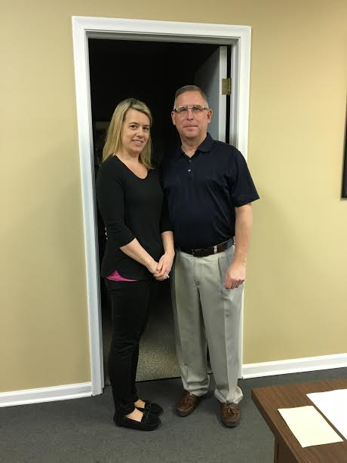
Career Field Experience
My Accounting Experience
Shelby Lane

Slide 2
Introduction
On Quotegarden.com I found a quote by Maltbie Babcock that read “opportunities do not come with their values stamped upon them”. This quote stood out to me because the experience I received from working at BRS Accounting was incredibly valuable. I have learned so much the past six months, all of which I wouldn’t have ever learned in a classroom. I became interested in accounting my sophomore year. Being the only sophomore in an all senior accounting class, I was the only one who paid attention. I really understood what was being taught and it was super fun. Everybody else seemed to hate the class, but it was the only class I looked forward to that trimester.

Slide 3
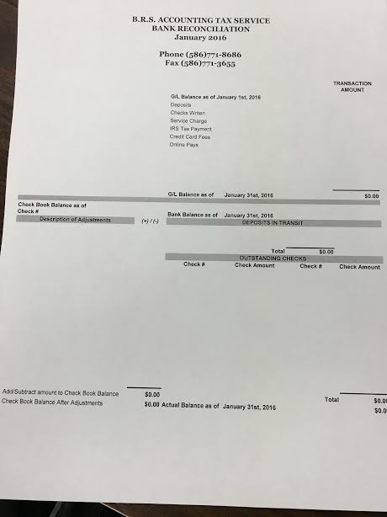
Responsibilities
Organize and maintain financial records
Examine financial statements
Inspect account books and accounting systems
Payroll
Assess financial operations and make recommendations to management
Suggest ways to reduce costs, enhance revenues, and improve profits
Compute taxes

Slide 4
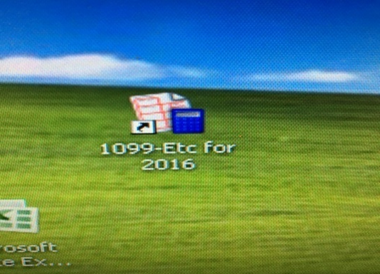
How to do a Payroll
Put the checks in the printer
Write the check number next to the employees name.
Open up the payroll program
Type in the account number
Insert the information for each check
Hit “print check” button
Print out the reports needed
Put the payroll in an envelope to be picked up

Slide 5
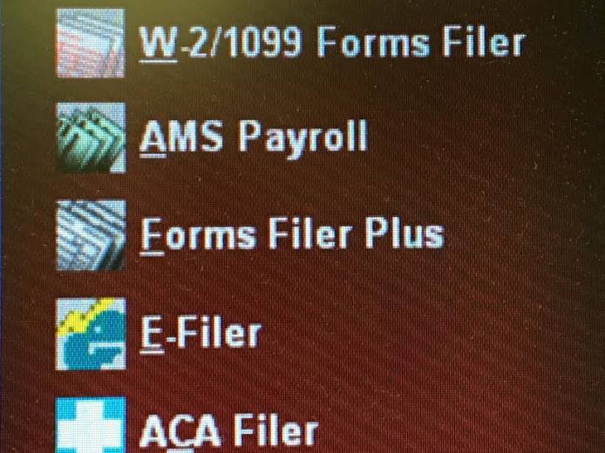
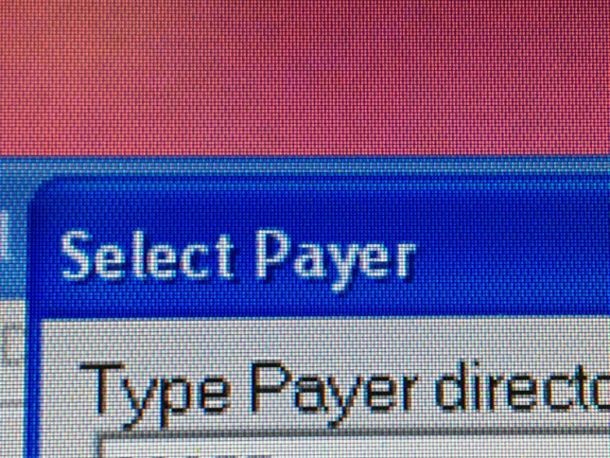
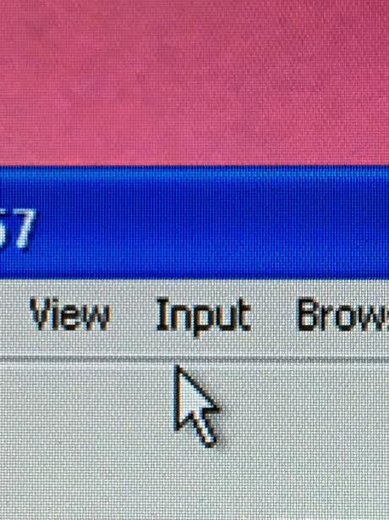
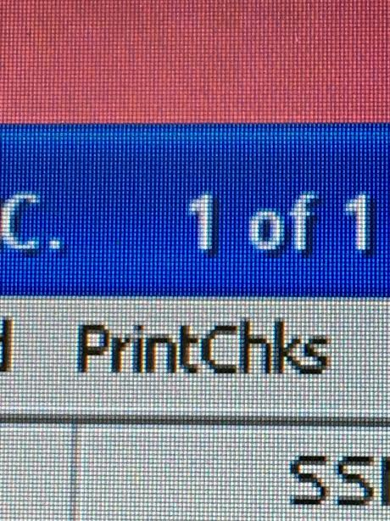
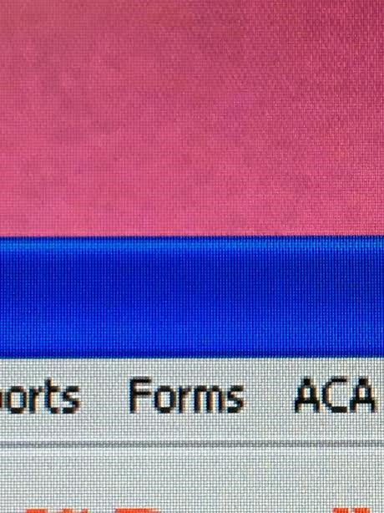

Slide 6
Training, Qualifications, Education
Bachelors degree or higher in accounting or a related field
CPA (Certified Public Accountant)
Must pass exam to become certified
I will be going to Macomb and Wayne State
I have taken Accounting I and Accounting II

Slide 7
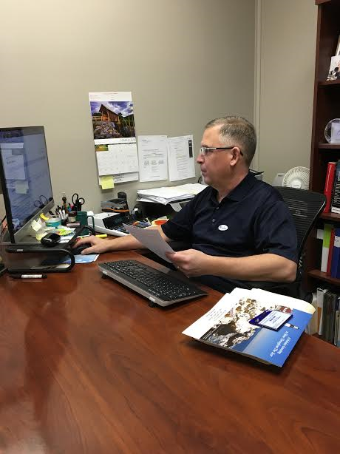
Bob Eder Jr
“ It is inspiring to work with the public in such a trusting position with all of their financial information and to help businesses stay in good standing with the government”
– Bob Eder Jr

Slide 8
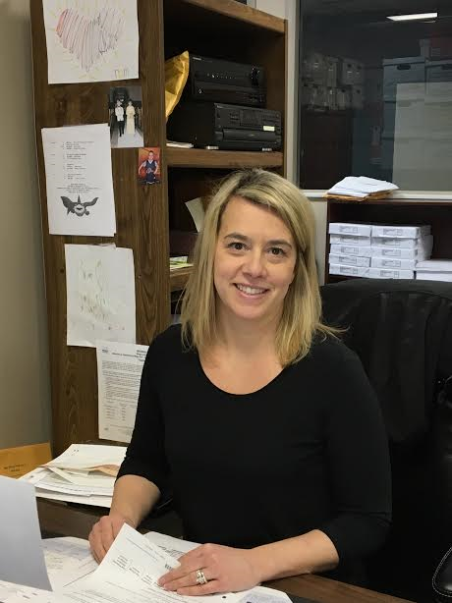
Beth Eder- Geill
“The purpose of a business is to create and keep customers. You keep customers by delivering on your promises, fulfilling your commitments, and continually investing in the quality of your relationships”
- Beth Eder- Geill

Slide 9
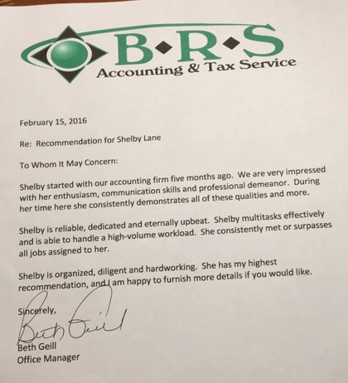
Quote from Letter of Recommendation
In the letter of recommendation I received from Beth, she wrote that they are impressed with my enthusiasm and communication skills. She said I am also able to handle a high volume workload.

Slide 10
Evaluations
Time management
Spend too much time on certain tasks
Problem Solving
I need to try harder to find solutions
Works without assistance
I am now able to receive work from Bobby between clients without having to ask a thousand questions
Gives attention to detail
I have an easier time finding mistakes now than I did earlier in my career experience

Slide 11
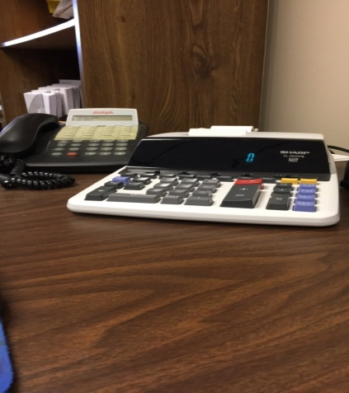
Completed goals
Bank recs
Payroll
Answering phones
Communication/ people skills

Slide 12
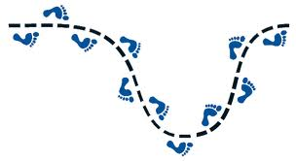
Next Step
Move to Chicago, Illinois
Work for a big company
Save lots of money
Move far, far away… someplace warm, of course

Slide 14
Citations
Quotegarden.com
http://www.bls.gov/OCO/

